Slide 1
WELCOME

Slide 2

COURIER MANAGEMENT SYSTEM

Slide 3
By
JIMIT ANDARPA (225480)
And
NEHA SHIRSAT(227389)
PROJECT GUIDE: SNEHA YADAV
SUPERVISOR: SMITA PATIL

Slide 4
Introduction
This project deals with the ‘Courier Management System ’. The system is used for daily activities such as booking, Booking history ,staff details, Branch details and pickup centers.
It is very difficult to do this process manually. Hence it is recommended to computerize the process by developing the relative software as the world is turning into information and technology; computerization becomes necessity in all walks of life.

Slide 5
Scope
Courier management system computerization is “the incorporate of appropriate technology to help administrator manage information. Technology is considered appropriate, when it utilizes the most abundant domestic resources and conserves capital and skilled personnel”.
This project deals with the maintenance of booking details, incoming courier details, courier non delivery details and courier return details etc. the main aim of this project is to computerize the maintenance of courier management.

Slide 6
Feasibility
Courier Management Software is only feasible if it delivers real world solutions for various problems. Yet, it is not good enough to provide a simple solution or solutions without having in mind satisfaction of all the user requirements, since courier business operations differ greatly compared to other systems with so many stages for successful deliveries. What’s more, a courier software should provide adaptive and flexible solutions so that organizations can easily incorporate them without disruptions to already operating business.

Slide 7
Problem Solving
The problem with this project is that we have to manually check the tracking number.
Future scope is that we will do it OTP base and will also add payment mode.
after successfully booking courier. automatically send SMS on the both sender's or receiver's mobile.
both can track what's the courier status?

Slide 8
System Specifications
Software Requirements: -
Operating System : Windows / Linux any one
Programming language: PHP
Web-Technology: Open Source
Front-End: PHP
Back-End: MySQL
Web Server: Apache

Slide 9
Hardware Requirements:-
Pentium-IV(Processor).
256 MB Ram
512 KB Cache Memory
Hard disk 10 GB
Microsoft Compatible 101 or more Key Board

Slide 10
Abstract
We are going to build a application related to Courier Management System which has following modules:
Admin Module
Staff Module.
User Module
Admin Module
In this section admin can see all detail in brief like total courier, Total Courier Pickup, Total Shipped, Total In-transit, Total Courier arrived at destination, Total courier out for delivery and Total delivered courier.
Admin can manage branches (add and update), Staffs(add, update and delete).
Admin can view courier status and check the courier detail which is filling by staff of different branches.
Admin can view courier details, courier counts and sales report according to dates.
Admin can also update his profile, change password and recover password.

Slide 11
Staff Module
In this section staffs can see all detail in brief like total courier , Total Courier Pickup, Total Shipped, Total In-transit, Total Courier arrived at destination, Total courier out for delivery and Total delivered courier.
staffs can fill the courier detail of parcel.
staffs can view the courier details and they have also right to change courier status according to current status.
staffs can search particular courier with the help of tracking number/reference number
Staffs can also update his profile, change password and recover password.
User Module
In this module user can view current delivery status of his parcel and also view the different branches of Courier Company.

Slide 12
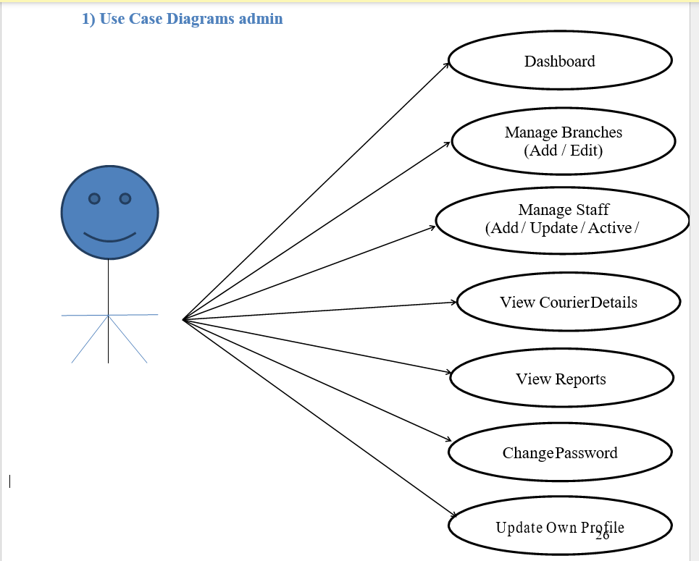

Slide 13
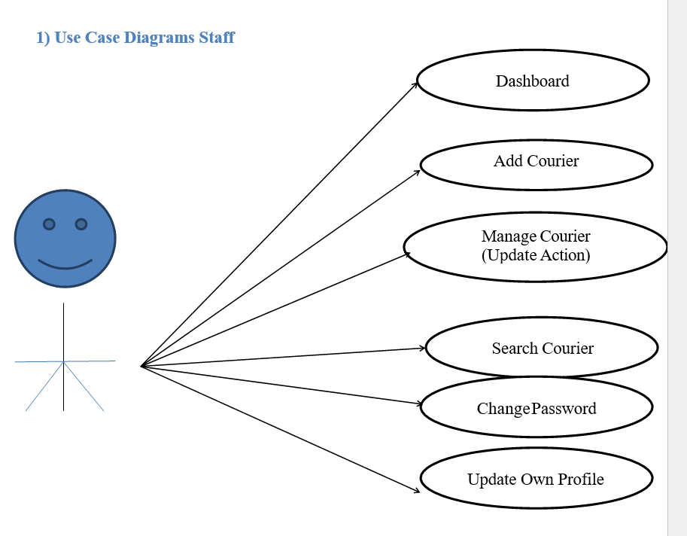

Slide 14
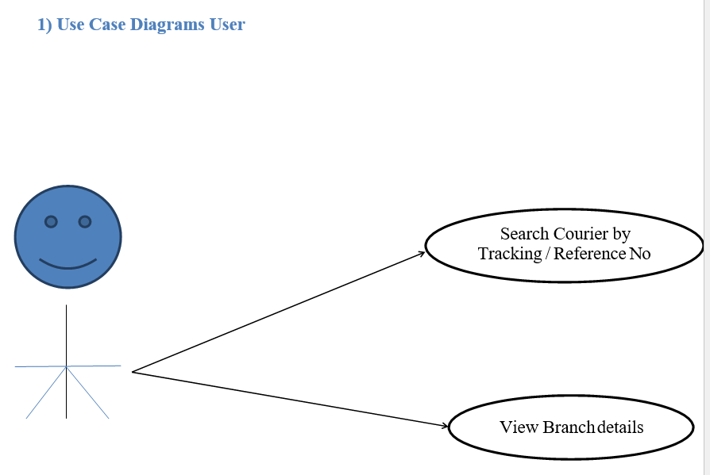

Slide 15
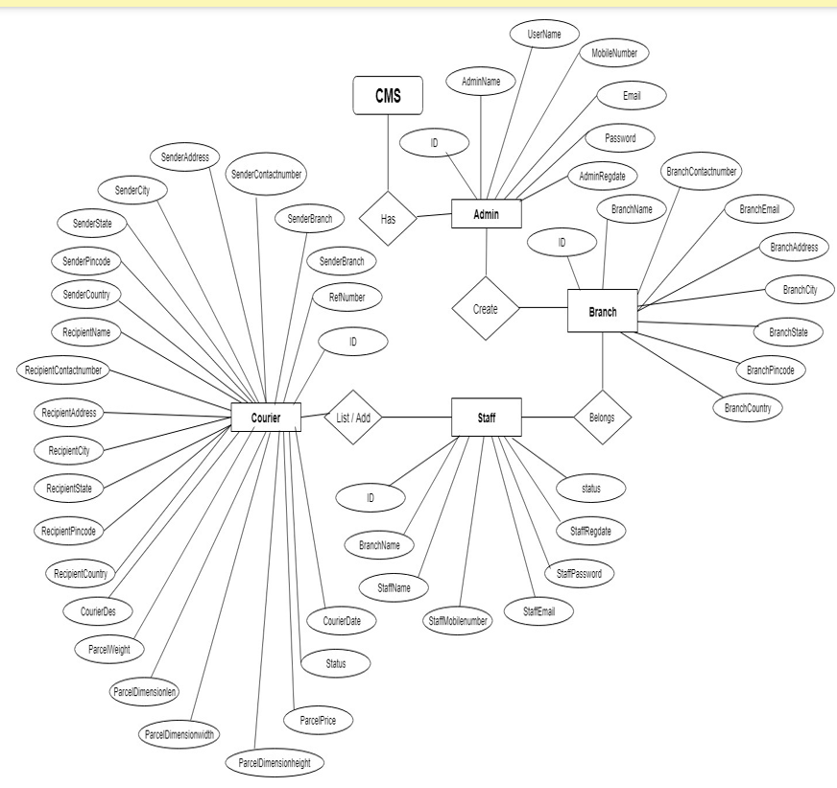
ENTITY-RELATIONSHIP Diagram

Slide 16
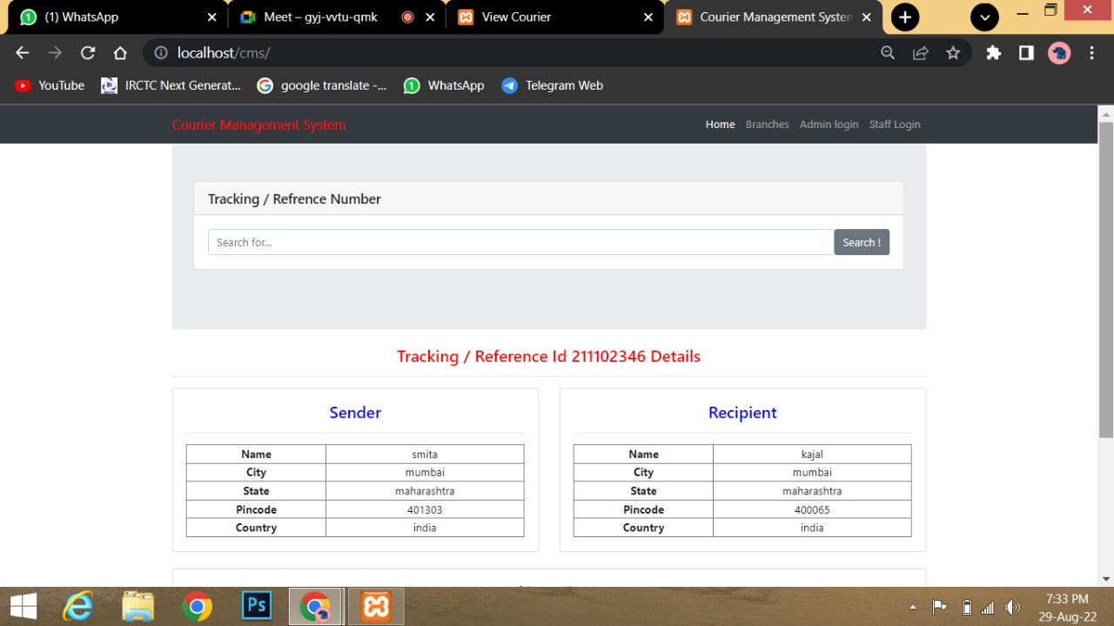
Output Screen

Slide 17
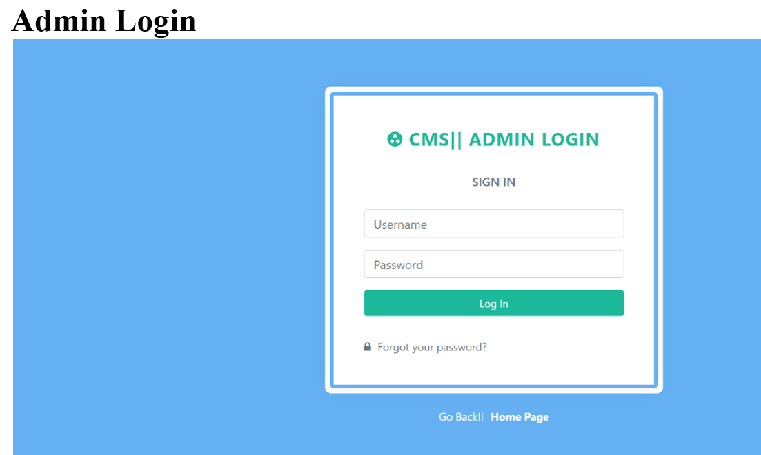

Slide 18
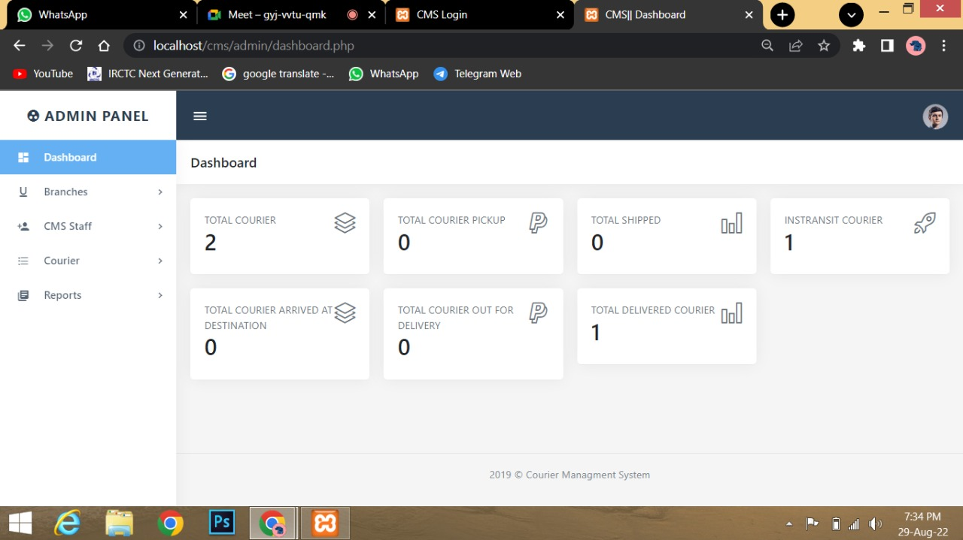

Slide 19
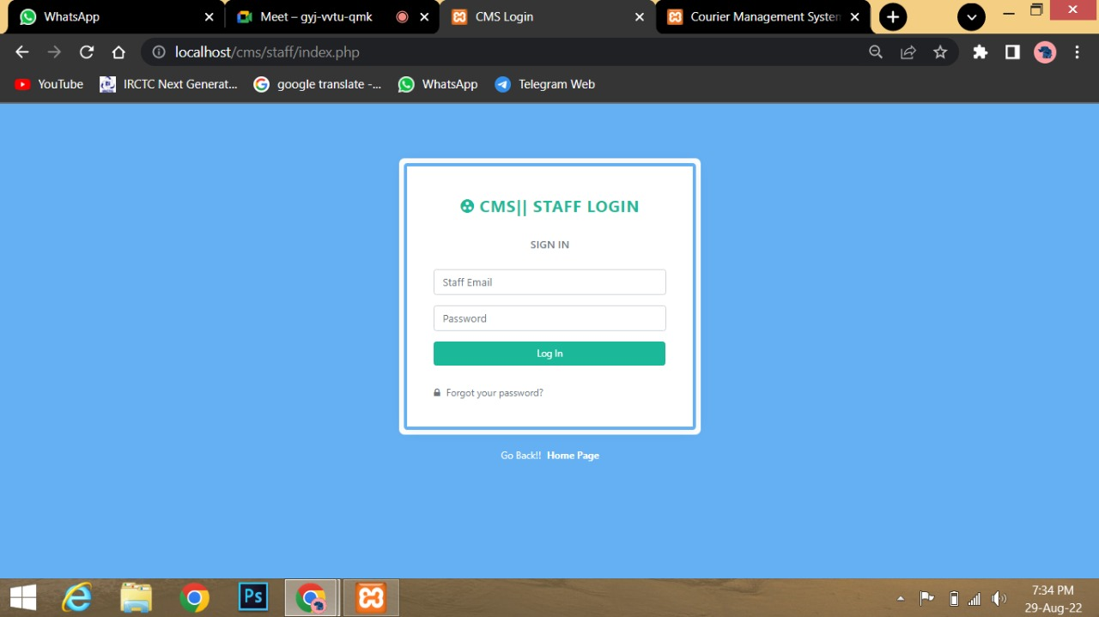

Slide 20
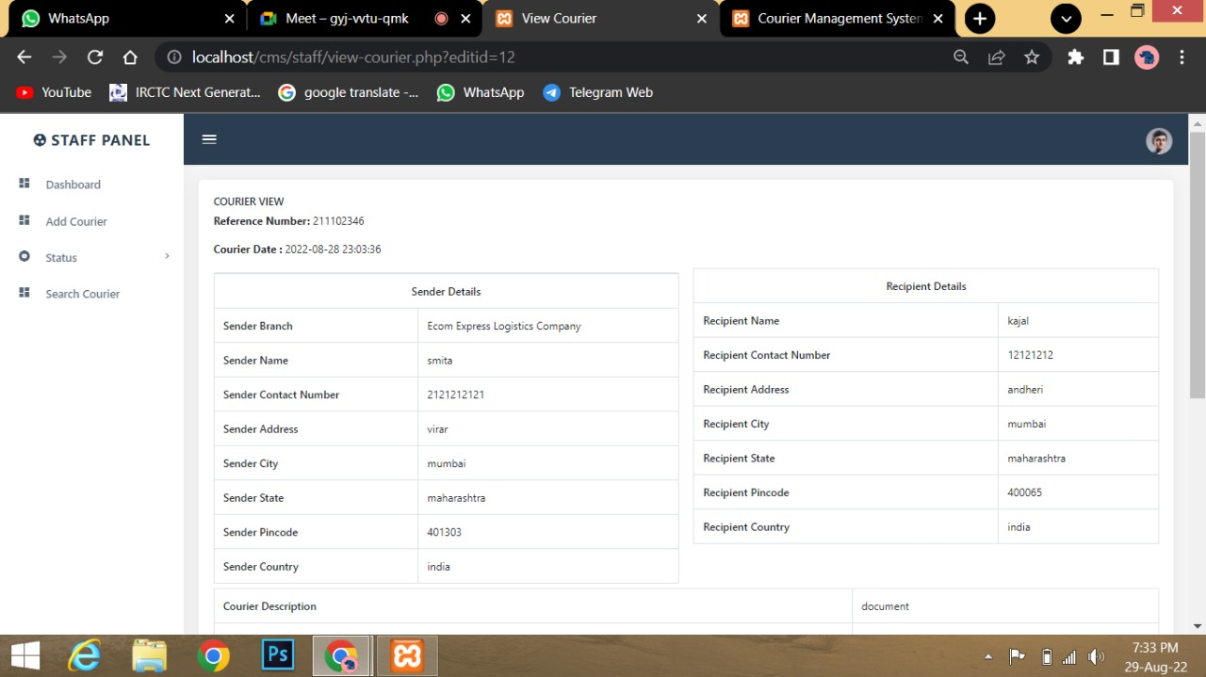

Slide 21
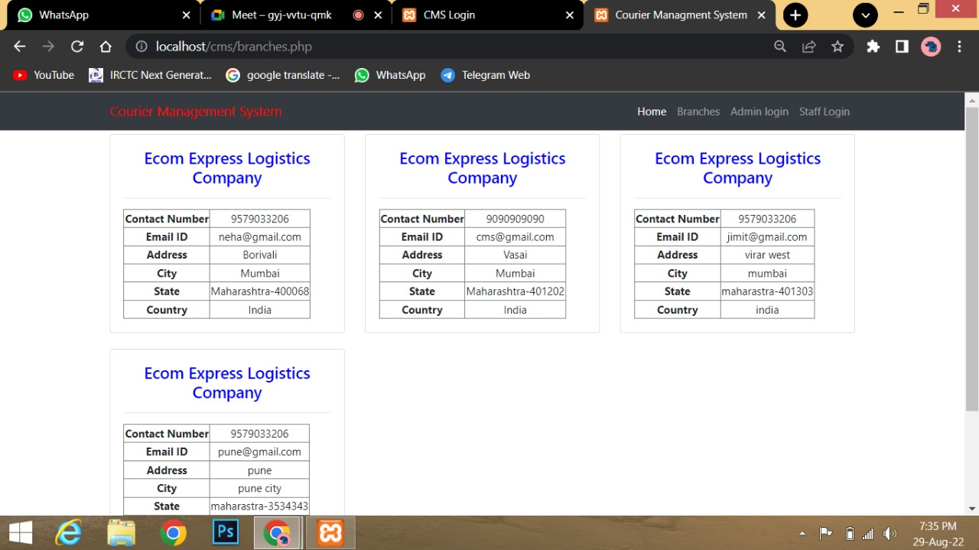

Slide 22
Conclusion
The entire project has been developed and deployed as per the requirements stated by the user, it is found to be bug free as per the testing standards that is implemented. Any specification-untraced errors will be concentrated in the coming versions, which are planned to be developed in near future. The system at present does not take care off the money payment methods, as the consolidated constructs need SSL standards and are critically to be initiated in the first face, the application of the credit card transactions is applied as a developmental phase in the coming days. The system needs more elaborative technicality for its inception and evolution.

